Slide 1
Meeting 25/05/2020
Naudé Conradie
19673418

Slide 2
Code
n Choose r implemented
Due to element removal, less configurations are actually possible
Updated error checking
Updated file naming

Slide 3
File Hierarchy

Slide 4
Python Library Hierarchy

Slide 5
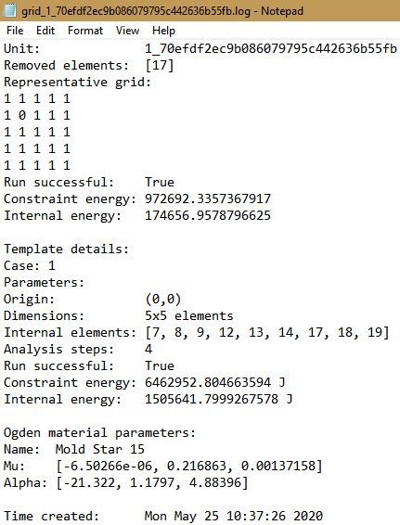
Log File

Slide 6
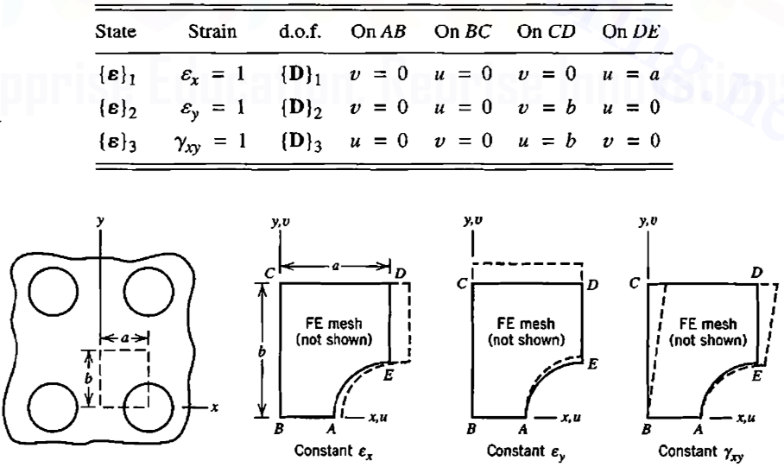

Templates
Implemented constant $ε_{y}$ and constant $γ_{xy}$
Assuming $ε_{x}=ε_{y}$ rotated by $90°$
Determine boundary conditions for other templates

Slide 7
Monte Carlo Simulations
Constraint energy
Formula
Internal energy
Summation of Total Strain Energy Density at all nodes
Template 1
Energy magnitude
Energy direction
How to handle negatives
Still need to implement for strain energy
Component 11 and 22 of strain energy

Slide 8
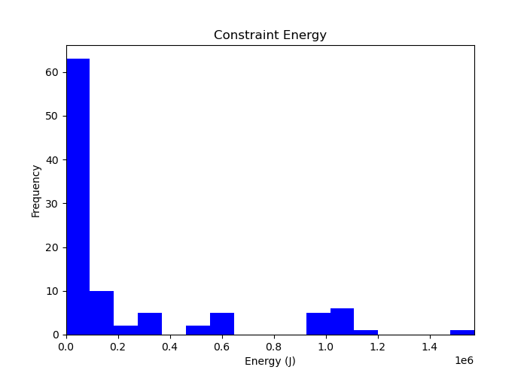
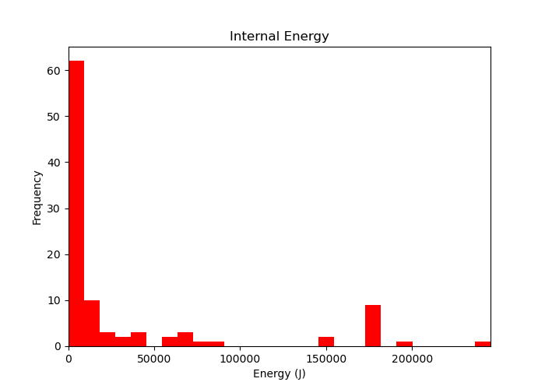
Histograms

Slide 9
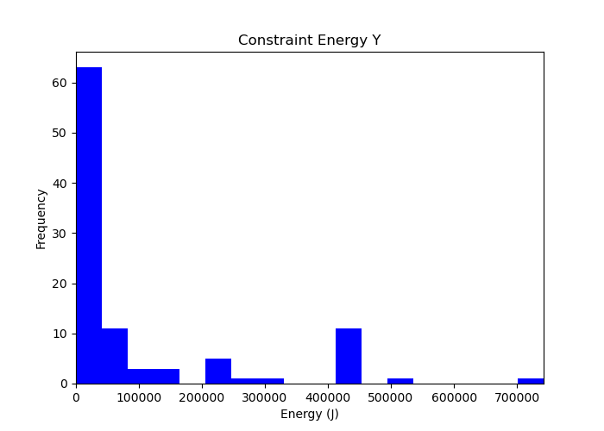
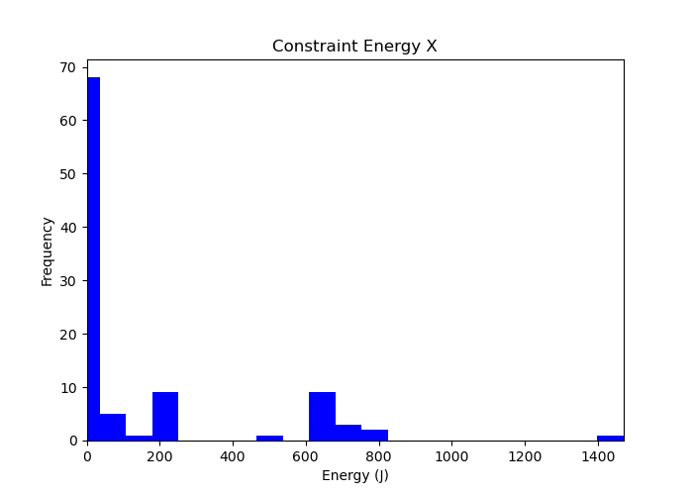
Histograms

Slide 10
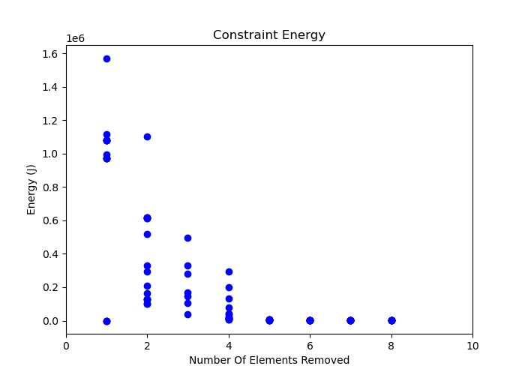
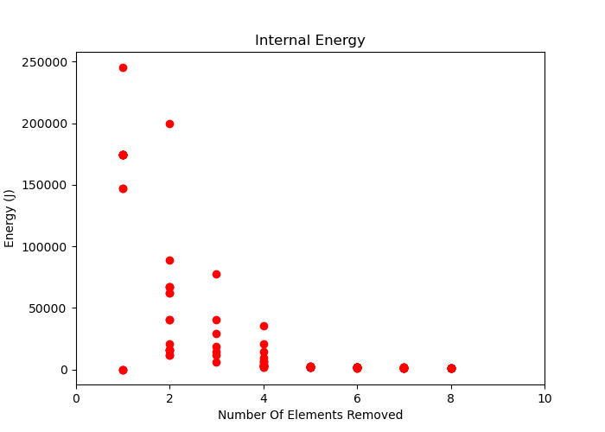
Scatter Plot

Slide 11
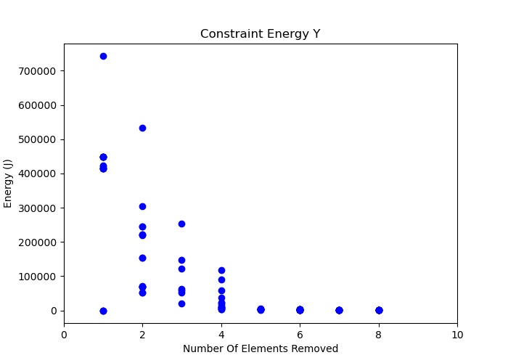
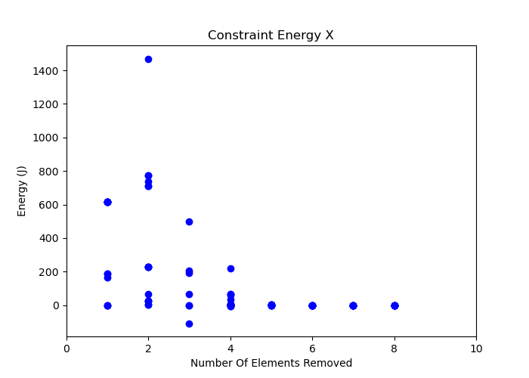
Scatter Plot

Slide 12
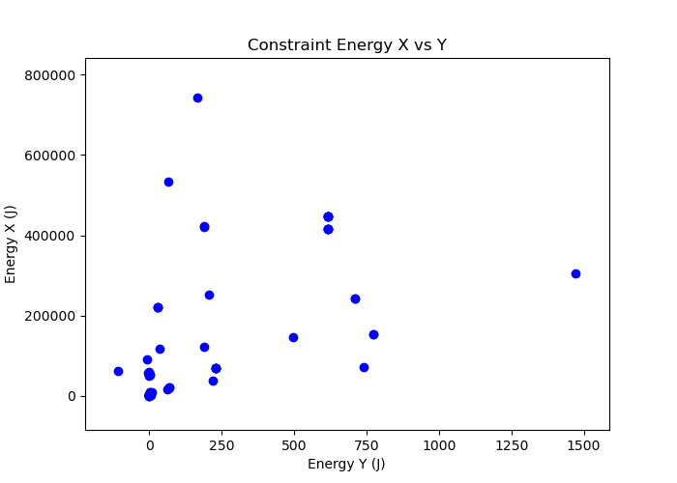
Scatter Plot

Slide 13
Admin
SSD
Quarterly report

